Slide 1
We use relative clauses to give additional information about something without starting another sentence. By combining sentences with a relative clause, your text becomes more fluent and you can avoid repeating certain words.

Slide 2
RELATIVE PRONOUNS
The following relative pronouns are used in defining relative clauses. These relative pronouns appear at the start of the defining relative clause and refer to a noun that appears earlier in the sentence.
 | Person | Thing | Place | Time | Reason
Subject | who/that | which/that
Object | who/whom/that | which/that | where | when | why
Possessive | whose | whose

Slide 3
Relative pronoun with examples
relative pronoun | use | example
who | Referrin to people | I told you about the woman who lives next door.
which | Referring to animals and things | Do you see the cat which is lying on the roof?
which | referring to a whole sentence | He couldn’t read which surprised me.
whose | possession for people, animals, and things | Do you know the boy whose mother is a nurse?
whom | Used in informal speech | I was invited by the professor whom I met at the conference.
that | Referring to people, animals and things (who or which are also possible) | I don’t like the table that stands in the kitchen.

Slide 4
Relative Adverbs
A relative adverb can be used instead of a relative pronoun plus preposition. This often makes the sentence easier to understand.
This is the shop in which I bought my bike.
→ This is the shop where I bought my bike.
relative adverb | meaning | use | example
when | in/on which | refers to a time expression | the day when we met him
where | in/at which | refers to a place | the place where we met him
why | for which | refers to a reason | the reason why we met him

Slide 5
Participle I

Slide 6
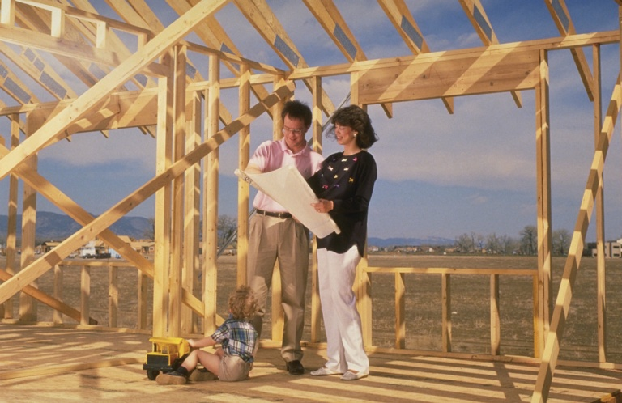
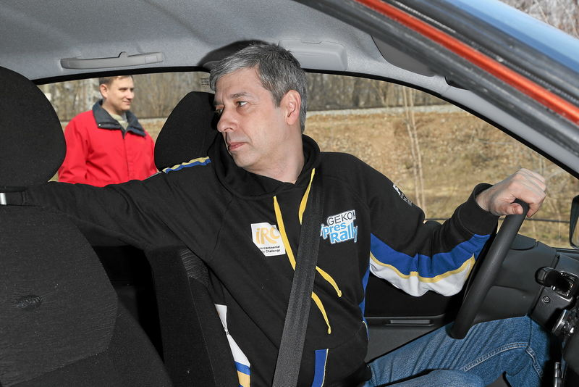
The man, parking his car by the shop.
Мужчина, паркующий свою машину около магазина.
The people, building our house with me, are my friends.
Люди, строящие наш дом вместе со мной, - мои друзья.

Slide 7
Participle I (The Present Participle)
Причастие настоящего времени
Причастие I образуется с помощью прибавления окончания –ing к инфинитиву глагола без частицы to. Например: go-going (ходить-идущий)
Если глагол оканчивается на –e, то при прибавлении окончания –ing буква –e отбрасывается: take-taking

Slide 8
При прибавлении окончания –ing конечная согласная удваивается, если ей предшествует ударная гласная, стоящая в закрытом слоге: cut-cutting
Если буква l является конечной, то при прибавлении окончания –ing она удваивается: travel- travelling
При прибавлении окончания –ing буквосочетание ie меняется на y: die-dying

Slide 9
Examples of using:
Примеры употребления:
The crying girl is my friend’s daughter. I need to talk to her.−Плачущая девочка − дочь моих друзей. Мне нужно с ней поговорить.
Reading a newspaper, she fell asleep. − Читая газету, она уснула.

Slide 10
I variant
Слушая музыку –
Плачущий ребёнок –
Смеющаяся девочка –
Играющие дети –
Спящая красавица –
II variant
Идущие люди –
Работающий мужчина –
Будучи смелыми –
Сидя в кресле –
Играя на площадке –

Slide 11
I variant
Слушая музыку – (listening to music)
Плачущий ребёнок – (a crying child)
Смеющаяся девочка – (a smiling girl)
Играющие дети – (playing children)
Спящая красавица – (the sleeping beauty)
II variant
Идущие люди – (going people)
Работающий мужчина – (a working man)
Будучи смелыми – (being brave)
Сидя в кресле – ( sitting in the armchair)
Играя на площадке – (playing in the yard)

Slide 12
Thank you for the lesson!

